Slide 1
CSE7101- Capstone Project Review-5
AI-job-Searching and Hiring Recommendation System
Batch Number: CSE_64
Roll Number
20221CSE0175
Student Name
KOVURI VASIF AFRIDI
C VENKATA PRAKASH CHOWDARY
MOHAN GANESH
Under the Supervision of,
Dr. Saurabh Sarkar , Ms.Poonam School of Computer Science and Engineering Presidency University
20221CSE0157
20221CSE0191
Name of the Program: B-Tech
Name of the HoD: Dr. BLESSED PRINCE
Name of the Program Project Coordinator: Dr. jayavadivel Ravi
Name of the School Project Coordinators: Dr. Sampath A K , Dr. Geetha A

Slide 2
Problem Statement Number:
Organization: presidency university
Category (Hardware / Software / Both) : software
Problem Description:In today’s globalized job market, job seekers often face multiple challenges when applying for positions across different regions and languages:
Language Barriers
Most job portals are designed for English-speaking users.
Candidates from regional backgrounds struggle to understand and apply for opportunities in other languages.
Lack of Personalized Recommendations
Existing job portals provide generic results.
They do not match resumes effectively with job postings, reducing chances of selection.

Slide 3
Problem Statement Number:
Manual and Time-Consuming Process
Applicants need to search, translate, and tailor resumes for each job manually.
This delays applications and reduces efficiency.
Limited Multilingual Support in Current Systems
Platforms like LinkedIn and Naukri offer very limited translation/localization features.
Regional candidates often miss out on opportunities outside their language domain.

Slide 4
Analysis of Problem Statement
Technology Stack Components:
Job seekers face significant challenges while applying for jobs across regions and countries, such as:
Language barriers that restrict access to job opportunities.
Lack of personalized job recommendations.
Manual and time-consuming application processes.
The project aims to overcome these challenges using Artificial Intelligence (AI) and Natural Language Processing (NLP) to create a multilingual job assistant.

Slide 5
Objectives
Build an AI-driven job assistant with multilingual support.
Provide real-time personalized job recommendations.
Enable resume parsing and keyword optimization to improve selection chances.
Integrate an interactive chatbot to guide users.
Ensure cross-platform accessibility (web & mobile).

Slide 6
Background & Related Work
Globalization has increased multilingual job applications.
Existing platforms like LinkedIn and Naukri have limited multilingual and AI- driven support.
Recent research in AI, NLP, and recommendation systems shows potential for bridging this gap.
Advances in machine translation (e.g., Google Translate, DeepL, Hugging Face models) enable real-time multilingual interactions.

Slide 7
Analysis of Problem Statement
Challenges:
Handling multiple languages & regional dialects.
Large dataset requirements for resumes & job descriptions.
Ensuring accuracy in resume-job matching.
Solution Approach:
Use pre-trained multilingual NLP models (mBERT, XLM-R).
Develop a recommendation engine based on job-resume similarity.

Slide 8
Analysis of Problem Statement
Build an AI chatbot for multilingual interactio

Slide 9
Innovation / Novel Contributions
AI-powered multilingual chatbot with real-time translation.
Resume keyword optimization tool for ATS (Applicant Tracking Systems).
Job recommendation engine customized for regional job markets.
Cross-platform support for web and mobile.

Slide 10
Literature Review for AI- Job Searching Assistant
Multilingual NLP
Models like mBERT, XLM-R enable cross-language translation & text understanding.
Useful for real-time job posting/resume translation
AI-based Job Recommendation
Modern systems use TF–IDF, embeddings, hybrid models.
Improves resume–job matching beyond keywords
Resume Parsing & Optimization
Uses NLP & NER to extract skills, education, experience.

Slide 11
Improves ATS-friendly shortlisting chances
AI Recruitment Chatbots
Provide FAQs, screening, and job guidance.
Enhances candidate experience with multilingual support.

Slide 12
Progress report (Fully Functional)
Requirement Analysis & Design
  Finalized system requirements and identified key functional modules.
  Designed workflow and conversation mapping.
  Selected technologies: Python, NLTK/Spacy, Flask, and MongoDB/MySQL.
Development Progress
  Implemented chatbot framework with intent recognition.
  Integrated basic NLP model for query understanding.
  Developed Resume Assistance Module ( feedback on format & skills).
  Built Job Recommendation prototype using dataset + keyword matching.

Slide 13
Progress report (Fully Functional)
Database created for user and admin interaction storage.
Testing
  Tested User Interface and admin Dashboard for small queries and performed debugging.
  Verified functionality of resume guidance and job recommendations.
  Checked out the Workshop, competition/Quiz, Interview, Chatbot for User Interface
  Checked out Live Applicant, User performance in Admin Interface

Slide 14
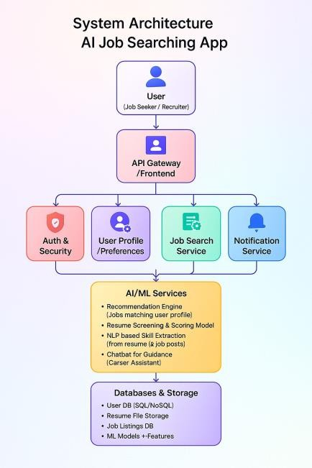
System Architecture for the Ai job Searching App

Slide 15
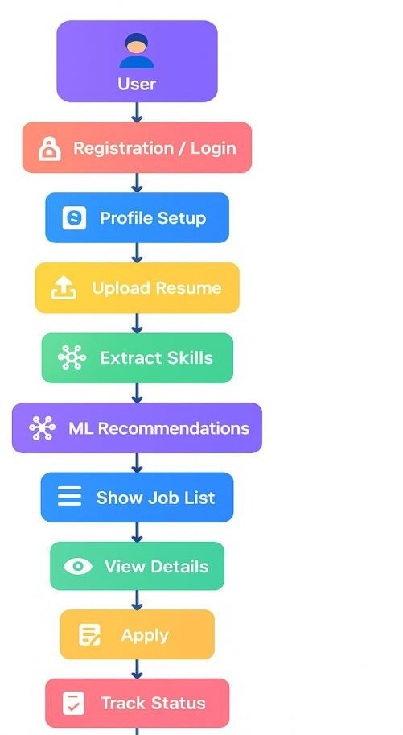
AI-Job Searching App : Flow chat

Slide 16
Project Modules
1. User Interface Module (Frontend)
Platform: Web / Mobile app.
Allows job seekers to interact with the system. Functions:
Enter job search queries. Upload resumes.
we recommended job results

Slide 17
Project Modules
2. Multilingual Translator Module
Converts queries, resumes, and job postings between multiple languages (English, Hindi, Telugu, etc.).
Uses NLP-based translation (mBERT, XLM-R, Hugging Face models). Helps break language barriers in job search.

Slide 18
Project Modules
3. Job Recommendation Engine
Matches candidate’s skills and preferences with available job postings. Current 20% → TF–IDF based recommender (prototype).
Future → Upgrade to embedding-based recommendation (BERT/Sentence Transformers)
5. Resume Parsing & Optimization Module
Extracts skills, education, and experience from uploaded resumes.
Optimizes resumes with ATS-friendly keywords. Matches candidate profiles against job requirements.

Slide 19
Project Modules
Chatbot Module
AI-driven virtual assistant to guide users. Provides:
FAQs and instructions. Job search assistance.
Resume improvement suggestions. Supports multilingual interaction.
Database Module
Stores job postings, resumes, and user interaction logs.
Supports efficient retrieval for job recommendation and resume parsing.

Slide 20
Fully integration
Enhance NLP capabilities with ML models (BERT/GPT-based).
Add advanced resume parser for skill extraction.
Improve job recommendation with ranking algorithms.
Develop interactive UI (Web/Mobile) for user interaction.
Add Interview Preparation Module (Q&A, tips).
Conduct user testing and finalize project documentation.

Slide 21
Github Link
The Github link provided should have public access permission.
Github Link : https://github.com/afridi0125/Ai_job_searching.git

Slide 22
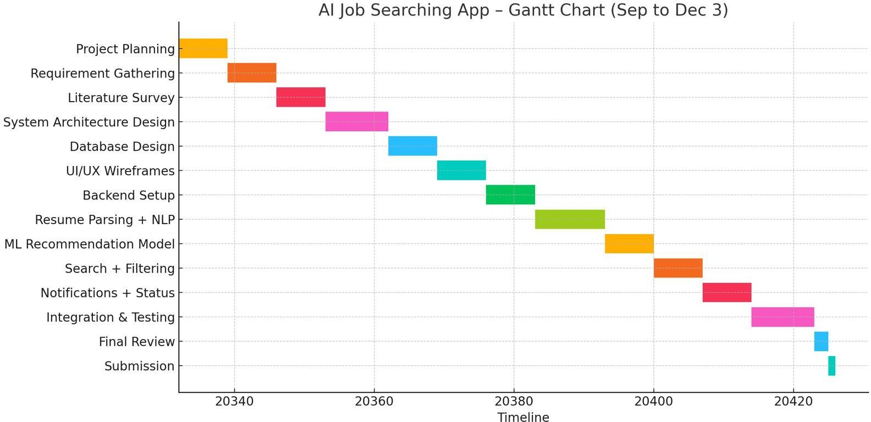
Timeline of the Project

Slide 23

References (IEEE Paper format)
S. T. Al-Otaibi and M. Ykhlef, “A Survey of Job Recommender Systems,” International
Journal of Physical Sciences, vol. 7, no. 29, pp. 5127–5142, Dec. 2012.
C. de Ruijt and S. Bhulai, “Job Recommender Systems: A Review,” arXiv preprint
arXiv:2111.13576, 2021.
S. Gupta, A. Singh, and V. Kumar, “Semantic Job Recommendation using BERT Embeddings,” IEEE Access, vol. 9, pp. 76543–76557, 2022.
A. Brek and Z. Boufaida, “Semantic Approaches Survey for Job Recommender Systems,”
CEUR Workshop Proceedings, vol. 3176, 2020.
H. Zhang, L. Chen, and M. Liu, “Reinforcement Learning in Personalized Recommender Systems,” IEEE Transactions on Knowledge and Data Engineering, vol. 35, no. 3, pp. 4201–
4214, 2023.
W. Shalaby, B. AlAila, M. Korayem, and W. Zadrozny, “Help Me Find a Job: A GraphBased Approach for Job Recommendation at Scale,” arXiv preprint arXiv:1801.00377, 2018. [7] HireVue Inc., “HireVue AI Platform,” 2024. [Online]. Available: https://www.hirevue.com/
[8] Hiretual, “Hiretual AI Recruiting Platform,” 2024. [Online].
Available: https://www.hiretual.com/
Initial testing & debugging of implemented modules
Week 12
1 week
Completed

Slide 24
References (IEEE Paper format)
D. Ç. Ertuğrul and S. Bitirim, “Job Recommender Systems: A Systematic Literature
Review (2010–2023),” Journal of Big Data, vol. 12, p. 140, 2025.
Y. Mashayekhi, N. Li, B. Kang, and T. De Bie, “A Challenge-Based Survey of
eRecruitment Recommendation Systems,” arXiv preprint arXiv:2209.05112, 2022.
Y. Mashayekhi et al., “ReCon: Reducing Congestion in Job Recommendation using Optimal Transport,” arXiv preprint arXiv:2308.09516, 2023.
P. Singla and V. Verma, “An Intelligent Job Recommendation System Based on Semantic
Embeddings and Machine Learning,” Journal of Information Systems Engineering and
Management, vol. 10, no. 5, pp. 520–542, 2025.
H. Wang and Y. Xu, “Hybrid Deep Neural Networks for Semantic Job Matching,” IEEE
Access, vol. 10, pp. 88321–88340, 2022.
L. Li, M. Xie, and R. Zhao, “Ontology-Based Resume–Job Matching for Intelligent
Recruitment,” Knowledge-Based Systems, vol. 240, p. 108076, 2022.
J. Zhou and Q. Chen, “Graph Neural Networks for Context-Aware Job
Recommendation,” Expert Systems with Applications, vol. 220, p. 119722, 2023.
M. Dascălu, C. H. Popescu, and I. J. Smeureanu, “CareProfSys: Ontology-Based Career Profiling and Recommendation System,” Procedia Computer Science, vol. 192, pp. 565– 574, 2021.

Slide 25
References (IEEE Paper format)
M. Ndolo, “A Review of Intelligent Recruitment and Employment Recommendation Systems,” International Journal of Computer Applications, vol. 183, no. 18, pp. 10–17, 2022.
N. Thali and S. Mayekar, “Machine Learning Approaches for Job Recommendation: A Comprehensive Survey,” International Journal of Engineering and Advanced
Technology, vol. 11, no. 6, pp. 45–55, 2023.
R. Kumar and P. Reddy, “Domain-Based Resume Classification using Deep
Convolutional Neural Networks,” IEEE Access, vol. 11, pp. 47122–47133, 2023.
Microsoft, “LinkedIn Talent Solutions API Documentation,” 2024. [Online]. Available:
https://learn.microsoft.com/en

Slide 26


